Slide 1
SELF CAR DRIVING
Created by
DEVA M
Reg no:- 912321104005
3rd year cse
Sacs mavmm engineering college

Slide 2
Project outline
Problem statement
Proposed system /solution
System development approach
Algorithm and deployment
Result
Conclusion

Slide 3
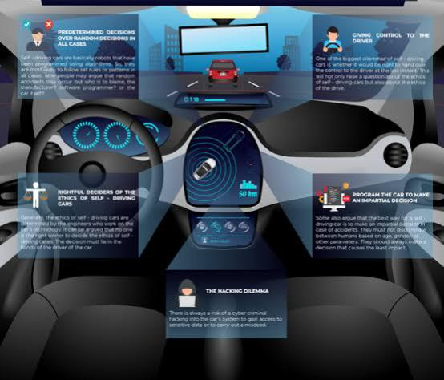
Problem statement
Safety:
Ensuring self-driving cars can reliably navigate different environments, handle unexpected situations, and interact safely with other road users.

Slide 4
2. Regulation:
Establishing legal frameworks and standards for autonomous vehicles to operate on public roads, addressing liability issues, and defining protocols for testing and certification
3. Technology:
Developing advanced sensors, AI algorithms, and computing systems capable of perceiving the environment, making real-time decisions, and safely controlling the vehicle.
4. Infrastructure:
Integrating self-driving technology with existing transportation infrastructure, such as road signs, traffic lights, and communication networks, to enable seamless operation.

Slide 5
Proposed system / solution
Sensor Fusion:
Integrating various sensors such as LiDAR, radar, cameras, and ultrasonic sensors to provide a comprehensive view of the vehicle's surroundings. Sensor fusion algorithms combine data from these sensors to accurately perceive the environment and detect obstacles, pedestrians, and other vehicles.
2. Artificial Intelligence:
Employing AI and machine learning algorithms to process sensor data, interpret the environment, predict the behavior of other road users, and make real-time decisions. Deep learning models are trained on vast amounts of data to recognize objects, understand traffic patterns, and navigate complex scenarios.

Slide 6
3. Mapping and Localization:
Creating high-definition maps of road networks and infrastructure, including lane markings, traffic signs, and landmarks. Precise localization techniques, such as GPS, inertial navigation, and simultaneous localization and mapping (SLAM), enable the vehicle to accurately position itself within its environment.
4. Control Systems:
Implementing robust control algorithms to steer, accelerate, and brake the vehicle safely and smoothly. Control systems take into account factors such as vehicle dynamics, road conditions, and traffic regulations to execute maneuvers while ensuring passenger comfort and safety.
5. Communication:
Utilizing vehicle-to-vehicle (V2V) and vehicle-to-infrastructure (V2I) communication systems to exchange information with other vehicles, traffic signals, and roadside units. This enables cooperative driving behaviors, such as platooning and intersection coordination, to improve traffic flow and safety.

Slide 7
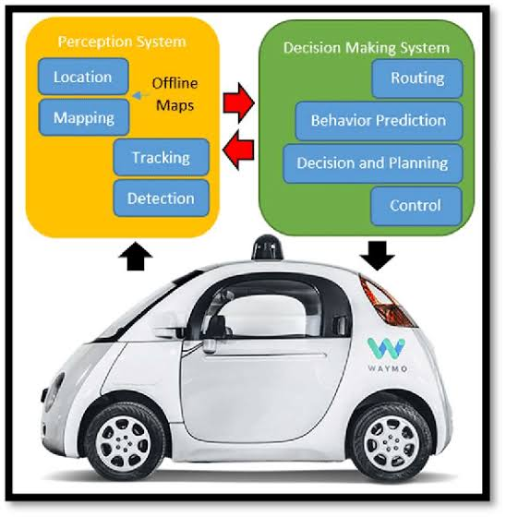
System development approach
The development of self-driving cars follows a systematic approach that involves several stages. It begins with gathering requirements from stakeholders to understand their needs and constraints. Once requirements are established, the conceptualization phase involves defining the system's architecture and high-level goals. Prototyping allows for early testing of critical components like sensors and algorithms. Subsequently, software development focuses on implementing perception, decision-making, and control algorithms. Hardware integration ensures seamless communication between sensors, actuators, and computing hardware. Rigorous testing and validation, both in simulated and real-world environments, assess the system's performance and safety. Regulatory compliance ensures adherence to relevant standards and regulations..

Slide 8
Algorithm and deployment
Perception Algorithms:
Object Detection and Tracking:
Algorithms identify and track objects such as vehicles, pedestrians, and cyclists in the vehicle's surroundings using data from sensors like cameras, LiDAR, and radar.
Semantic Segmentation:
This algorithm classifies each pixel in an image into specific object categories, enabling the car to understand its environment in detail.
Lane Detection:
Algorithms detect lane markings on the road, allowing the vehicle to stay within its lane and navigate safely.

Slide 9
2. Decision-Making Algorithms:
Path Planning:
These algorithms generate a safe and optimal path for the vehicle to follow, taking into account factors like traffic rules, road geometry, and obstacles.
Trajectory Generation:
Based on the planned path, trajectory generation algorithms determine the vehicle's speed and steering commands to navigate through complex environments.
Behavior Prediction:
Algorithms predict the future behavior of other road users, enabling the vehicle to anticipate and react to their movements.

Slide 10
Result
self-driving cars were continuing to undergo development and testing by various companies like Tesla, Waymo, Uber, and others. While they show promise in certain environments, full adoption and widespread use are still pending regulatory approval, technological advancements, and addressing safety concerns. For the most recent developments and results, I recommend checking the latest news from companies and regulatory bodies involved in autonomous vehicle technology.

Slide 11
Conclusion
Meme generation using AI for conclusion involves creating a humorous or insightful image accompanied by a caption to summarize or draw a conclusion on a topic related to AI.
The image chosen for the meme typically reflects the theme or idea being concluded, which could include depictions of people nodding in agreement, celebrating success, or expressing surprise.

Slide 12
Reference
https://www.sciencedirect.com/science/article/pii/S1877050920317051
https://www.opensourceforu.com/2023/09/ai-and-ml-algorithms-that-power-self-driving-cars/
https://www.quora.com/What-problems-do-self-driving-cars-solve
Dataset link
https://www.kaggle.com/datasets/aslanahmedov/self-driving-carbehavioural-cloning/code

